Slide 1



Slide 2

BROADCASTING
FROM THE CLOUD
Using cloud infrastructures
to fulfil broadcasters needs
By David Fischer (github.com/davidfischer-ch),
Prof. : Andrés Revuelta / EBU : Bram Tullemans

Slide 3

Plan
What is EBU (3 slides)
Mass vs Personalized Media Delivery
IT/Files – Based Media Worflow
The Promise of Cloud Computing
The Project called OSCIED (a lot of slides)
OSCIED Application Architecture
Demonstrator v1.0, v2.29.40
Conclusion & Future
Questions & Answers

Slide 4
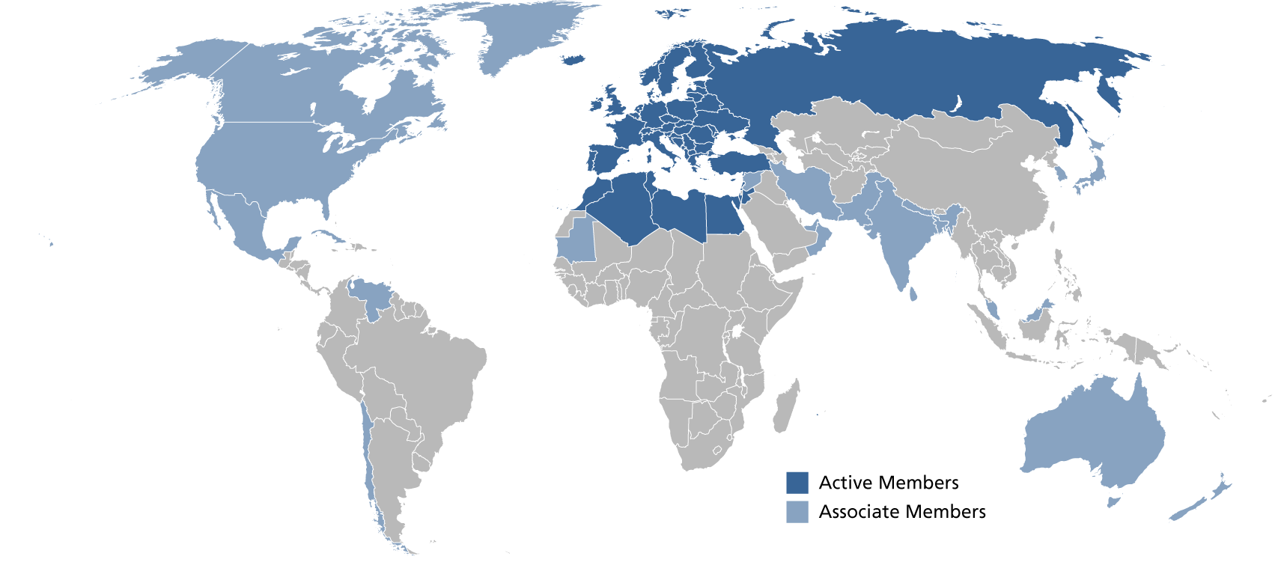
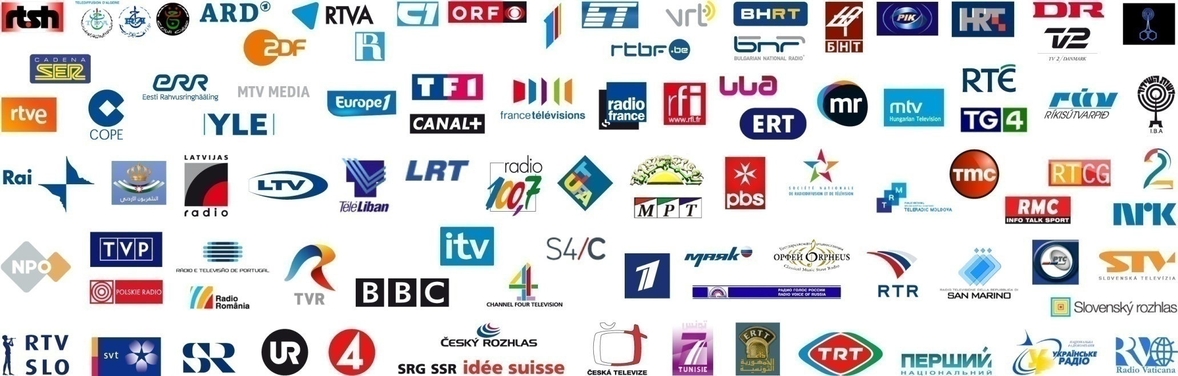
What is European Broadcasting Union ?
85 active members
in 56 countries and
35+ associate members around the world
500+ TV channels
1000+ radio channels
200+ million TV HH

Slide 5

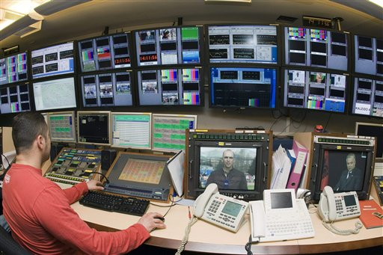
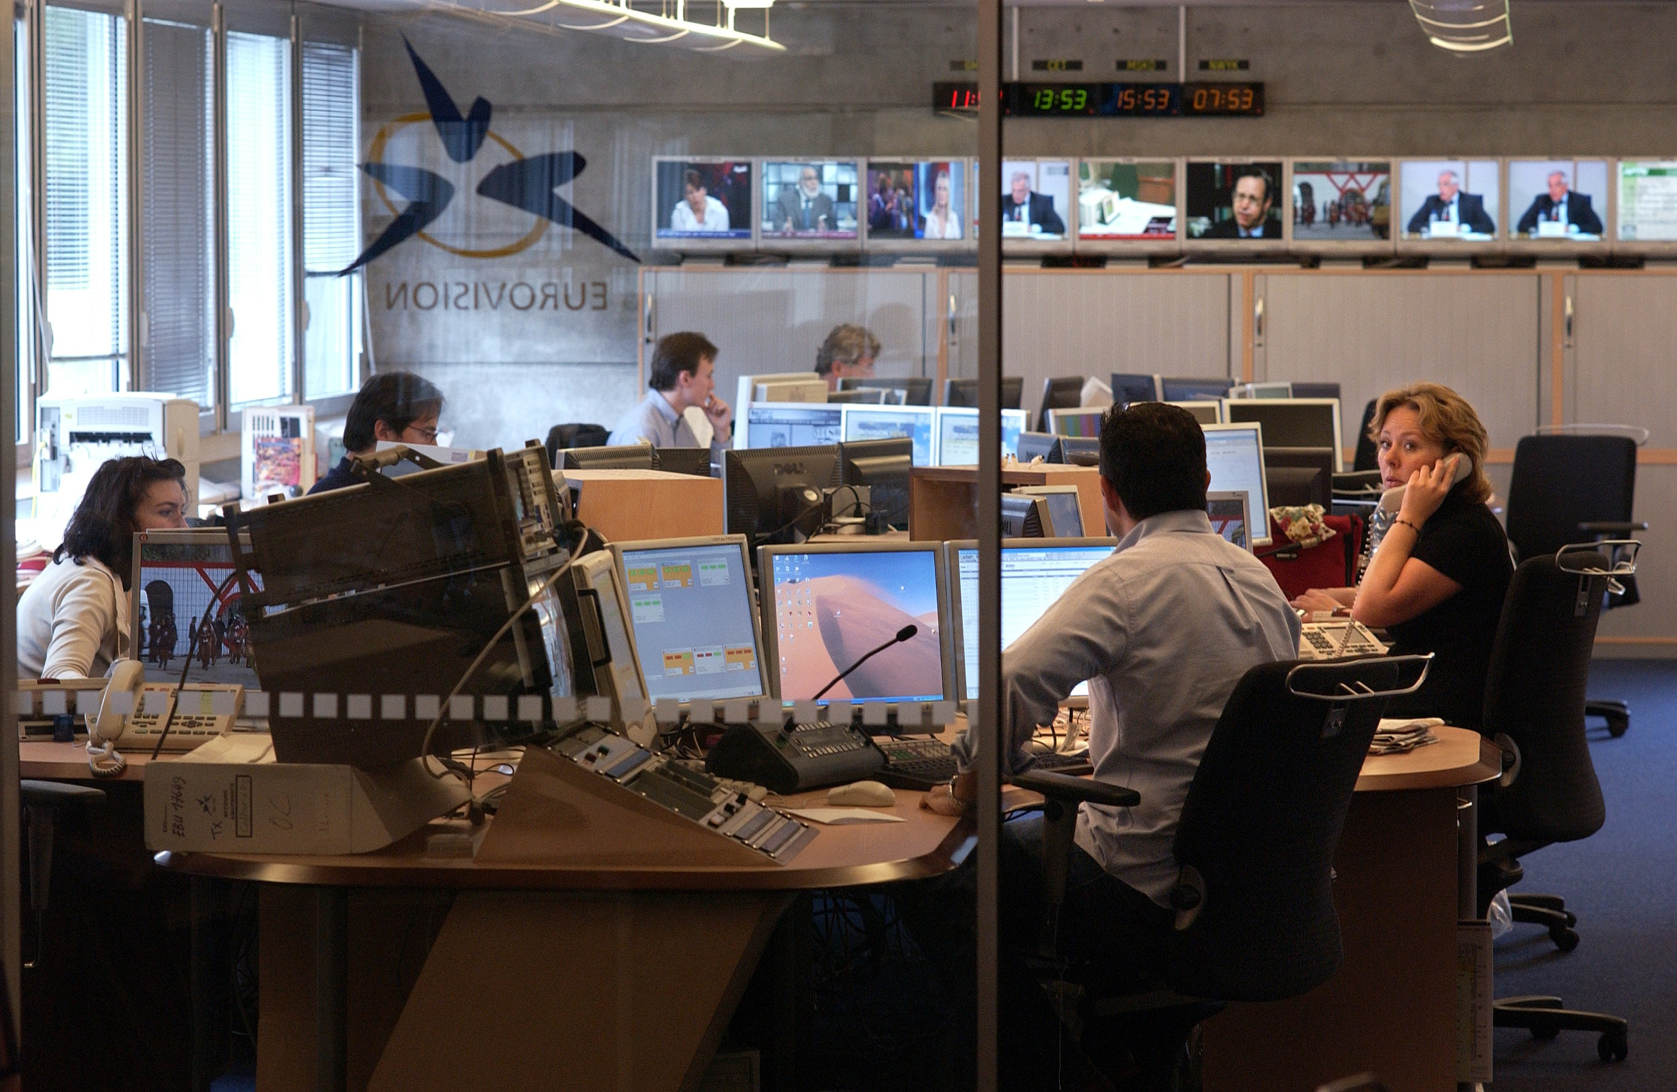
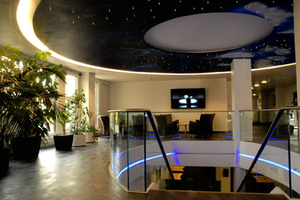
EBU's Headquarters (Geneva)

Slide 6
EBU Technology & Innovation
Mission
A common interest to cooperate and act on a European and worldwide level
To connect people and share their experiences and best practices
To advise and guide in technology developments and decisions
To drive innovation and develop the future of media in the best conditions for PSM and citizens
To promote and represent our values and insights in standardization, regulatory and industrial bodies
To harmonize market implementations and strive for interoperability
High level objectives
with the aim to
maximize COST and EFFICIENCY
improve QUALITY OF SERVICE and EXPERIENCE
maximize REACH
optimize STRATEGIC POSITIONING

Slide 7
Mass vs Personalized Media Delivery

Slide 8
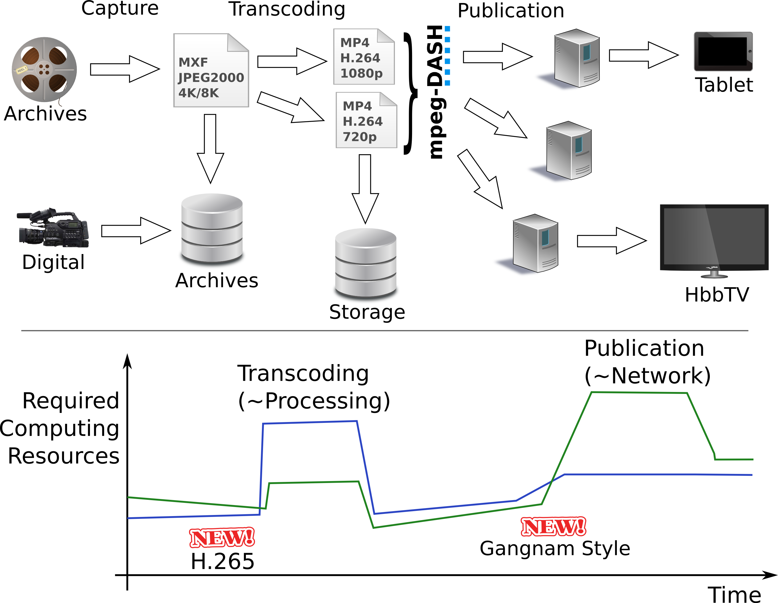
IT/Files - Based Media Workflow

Slide 9
The Promise of Cloud Computing
TODO CHARTS

Slide 10
Open-Source Cloud Infrastructure for Encoding and Distribution
Providing a scalable FLOSS media platform to members of EBU
A platform based on cloud-era FLOSS technologies, dedicated to :
  Transcoding of a wide collection of medias to new formats
  Online publication of popular medias
A platform that is designed to allow :
  Deployment of services in-house, enterprise IT infrastructure
  Scaling of transcoding and publication points to public clouds (IaaS)
  Ease of scale-up or scale-down of services
  Separation of development, testing and production environments
  Future features or capabilities (MPEG-DASH, auto-scaling, ...)

Slide 11
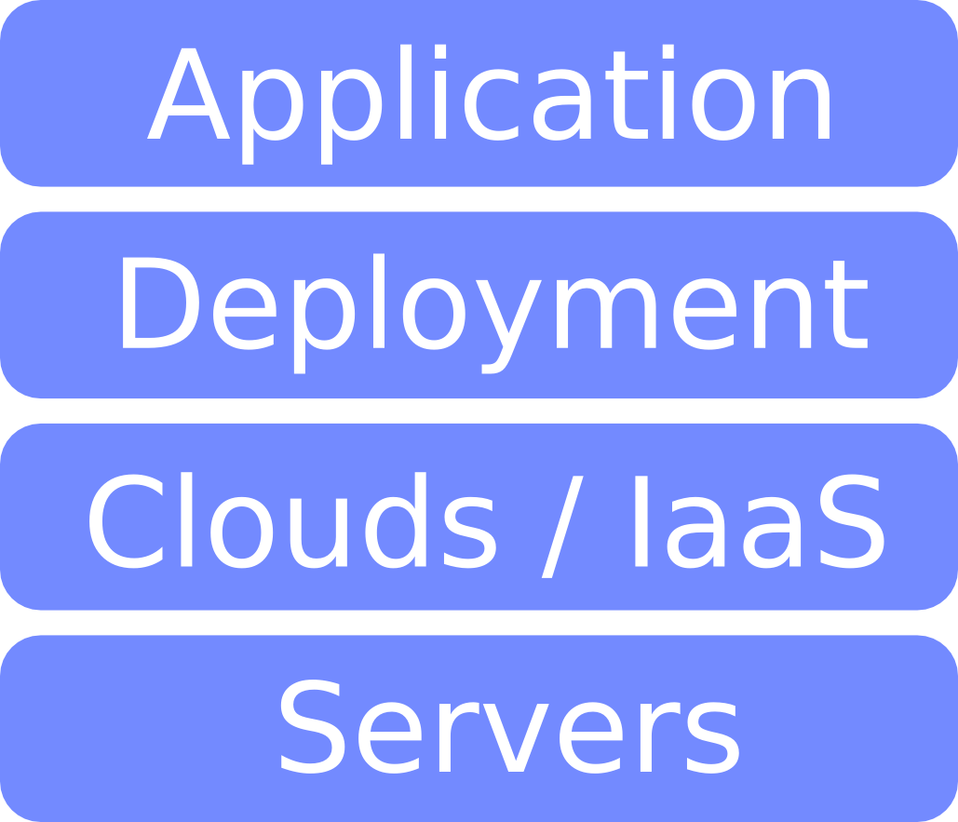
Layers of OSCIED (!= OSI)

Slide 12
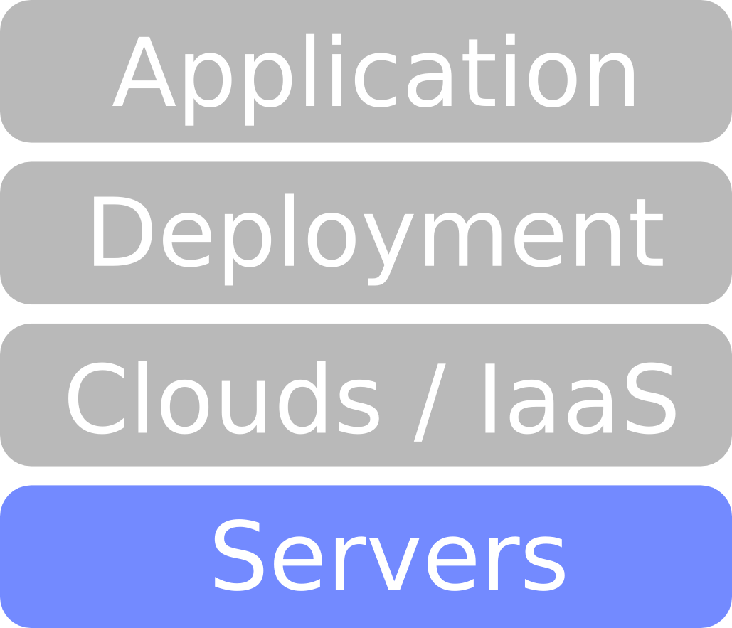
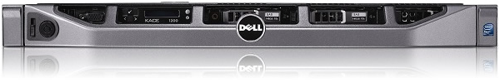
Servers Layer
A setup of 4x 1U servers chosen based on :
  Project's CAPEX (the cash)
  Optimization of configuration based on needs
  Ubuntu Server's certified HW list for Dell Servers
Dell PowerEdge R420
  2x Xeon E5-2430 2.20GHz, 15MB Cache, 7.2GT/s, 6C
  4x 4GB RDIMM 1333MT/s x8 Data Width
  HW RAID PERC H310 Mini + 2x 1TB 7.2K SATA

Slide 13
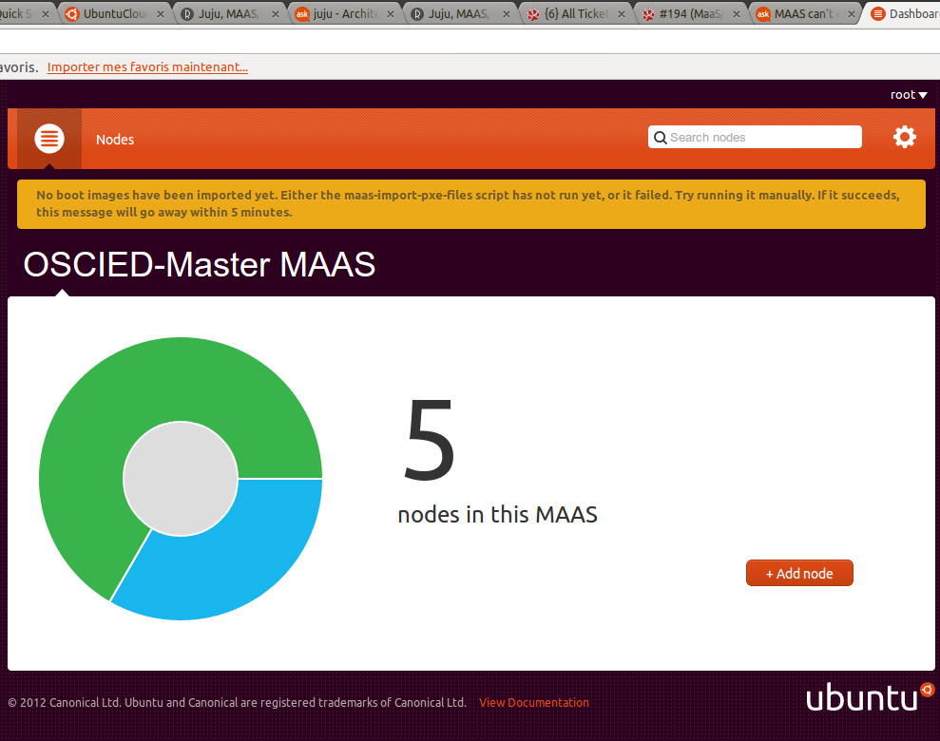
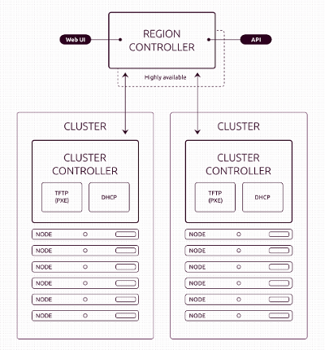
Servers Layer (MaaS)
Ease of servers provisionning (PXE install)
Driveable through an API (enable automation)
Developped to interact with JuJu

Slide 14
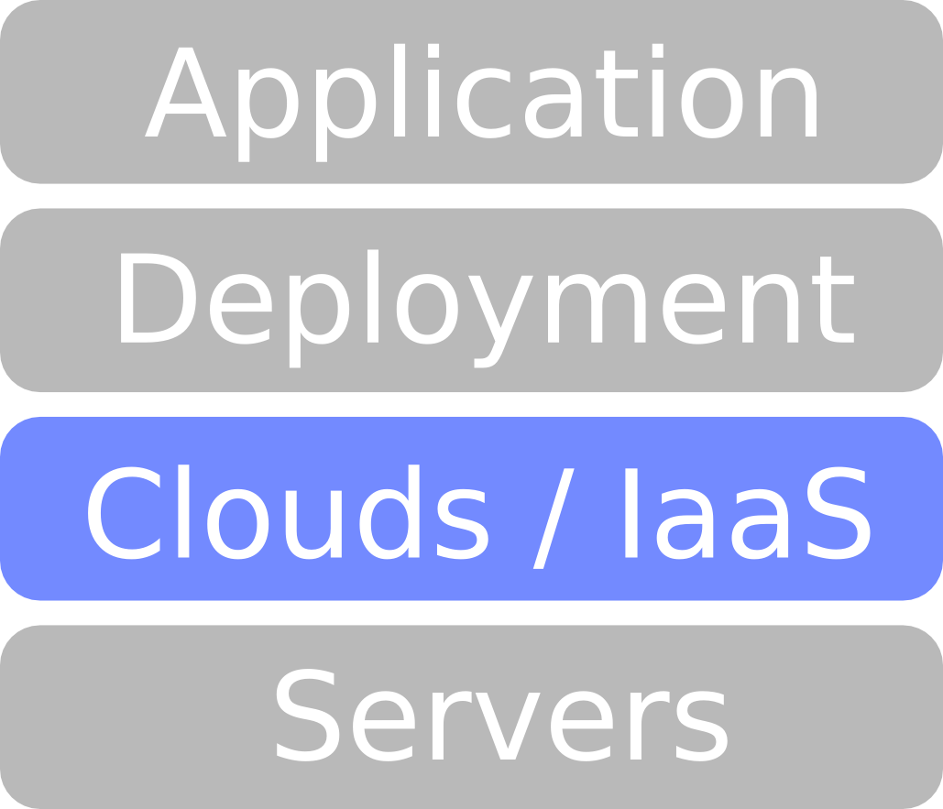
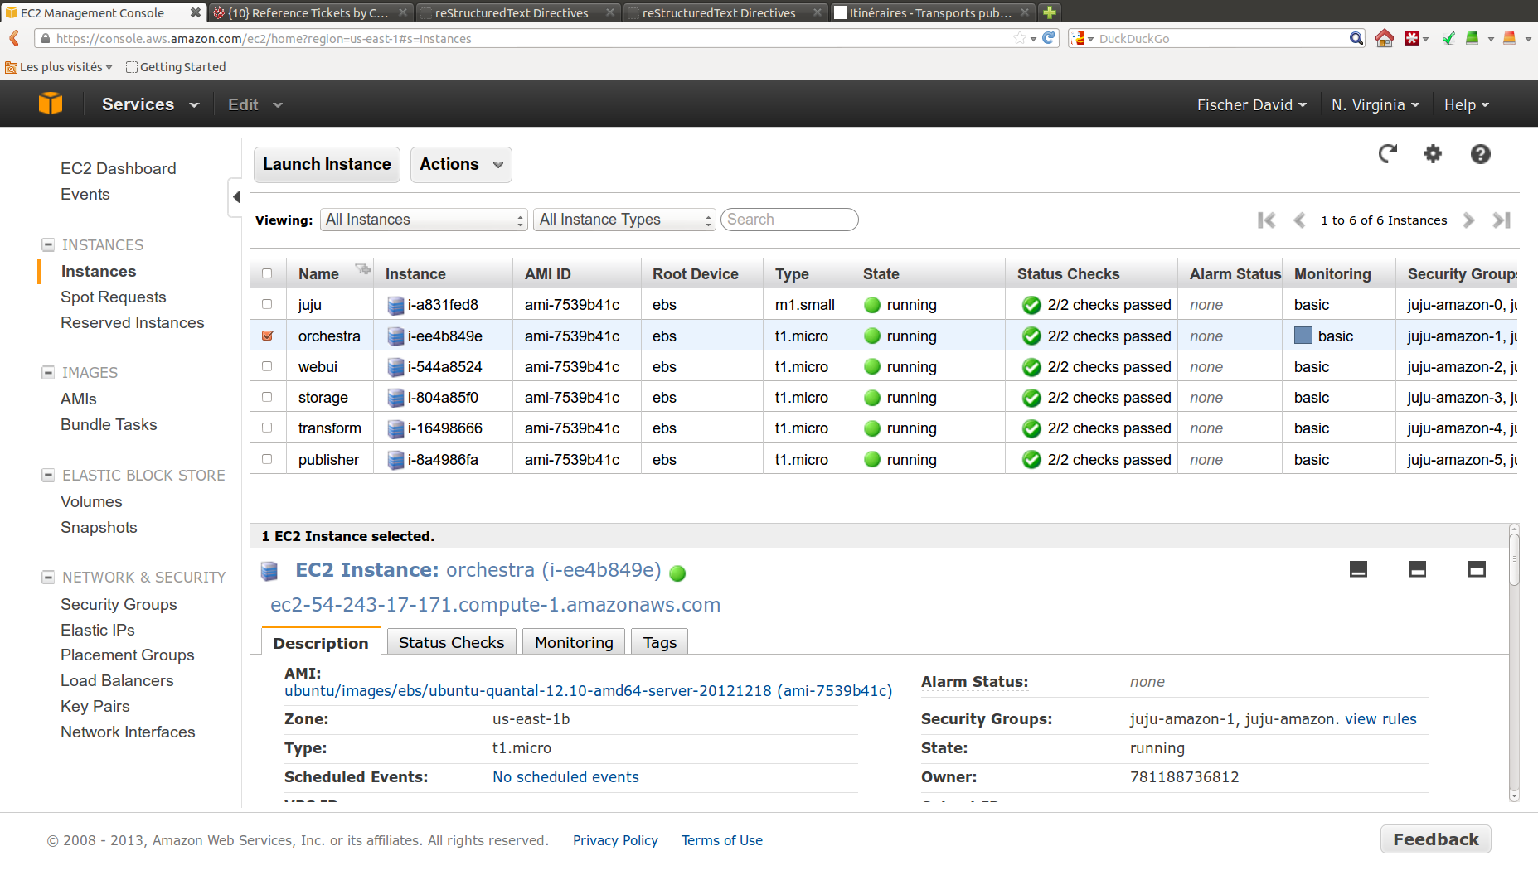
Clouds Layer (Amazon, ...)
« Amazon Elastic Compute Cloud (Amazon EC2) is a web service that provides resizable
compute capacity in the cloud. It is designed to make web-scale computing easier for
developers. »
Manageable through an API or WUI
Compute / network services :
  EC2 – Elastic Compute Cloud
  EMR – Cluster Hadoop
  Route 53 – DNS
Storage/CDN services :
  S3 – Simple Storage Service
  Glacier – Low-cost Archive Storage
  EBS – Elastic Block Storage
  CloudFront – Content Delivery Net.
Database services :
  RDS – Relational DB Services
  DynamoDB – NoSQL data store
Management services :
  AWS Management Console
VM Instances can be launched On-demand, Reserved (for 2 years) or Spot (if the price goes below 0.1$/h).
Instances Type will define allocated capacity :
#CPU, #MB RAM, iops ... $/h

Slide 15
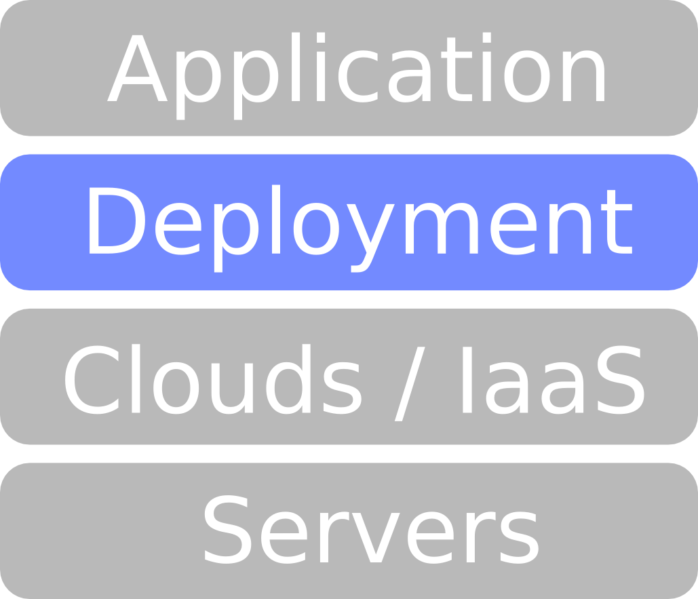
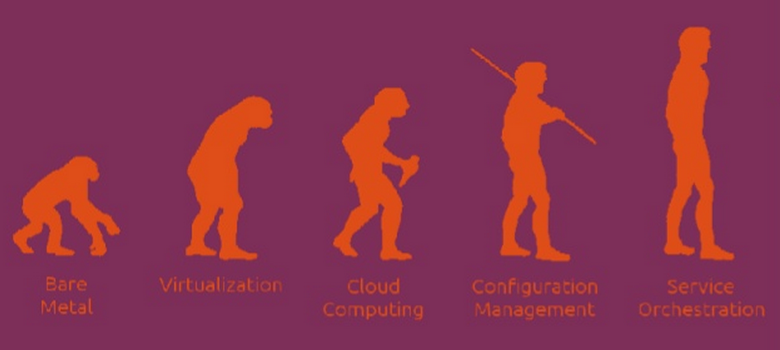
Services Orchestration ...
JuJu
(Chief, ...)
KVM, LXC
OpenStack
Servers
Copyright Hardik Dalwadi

Slide 16
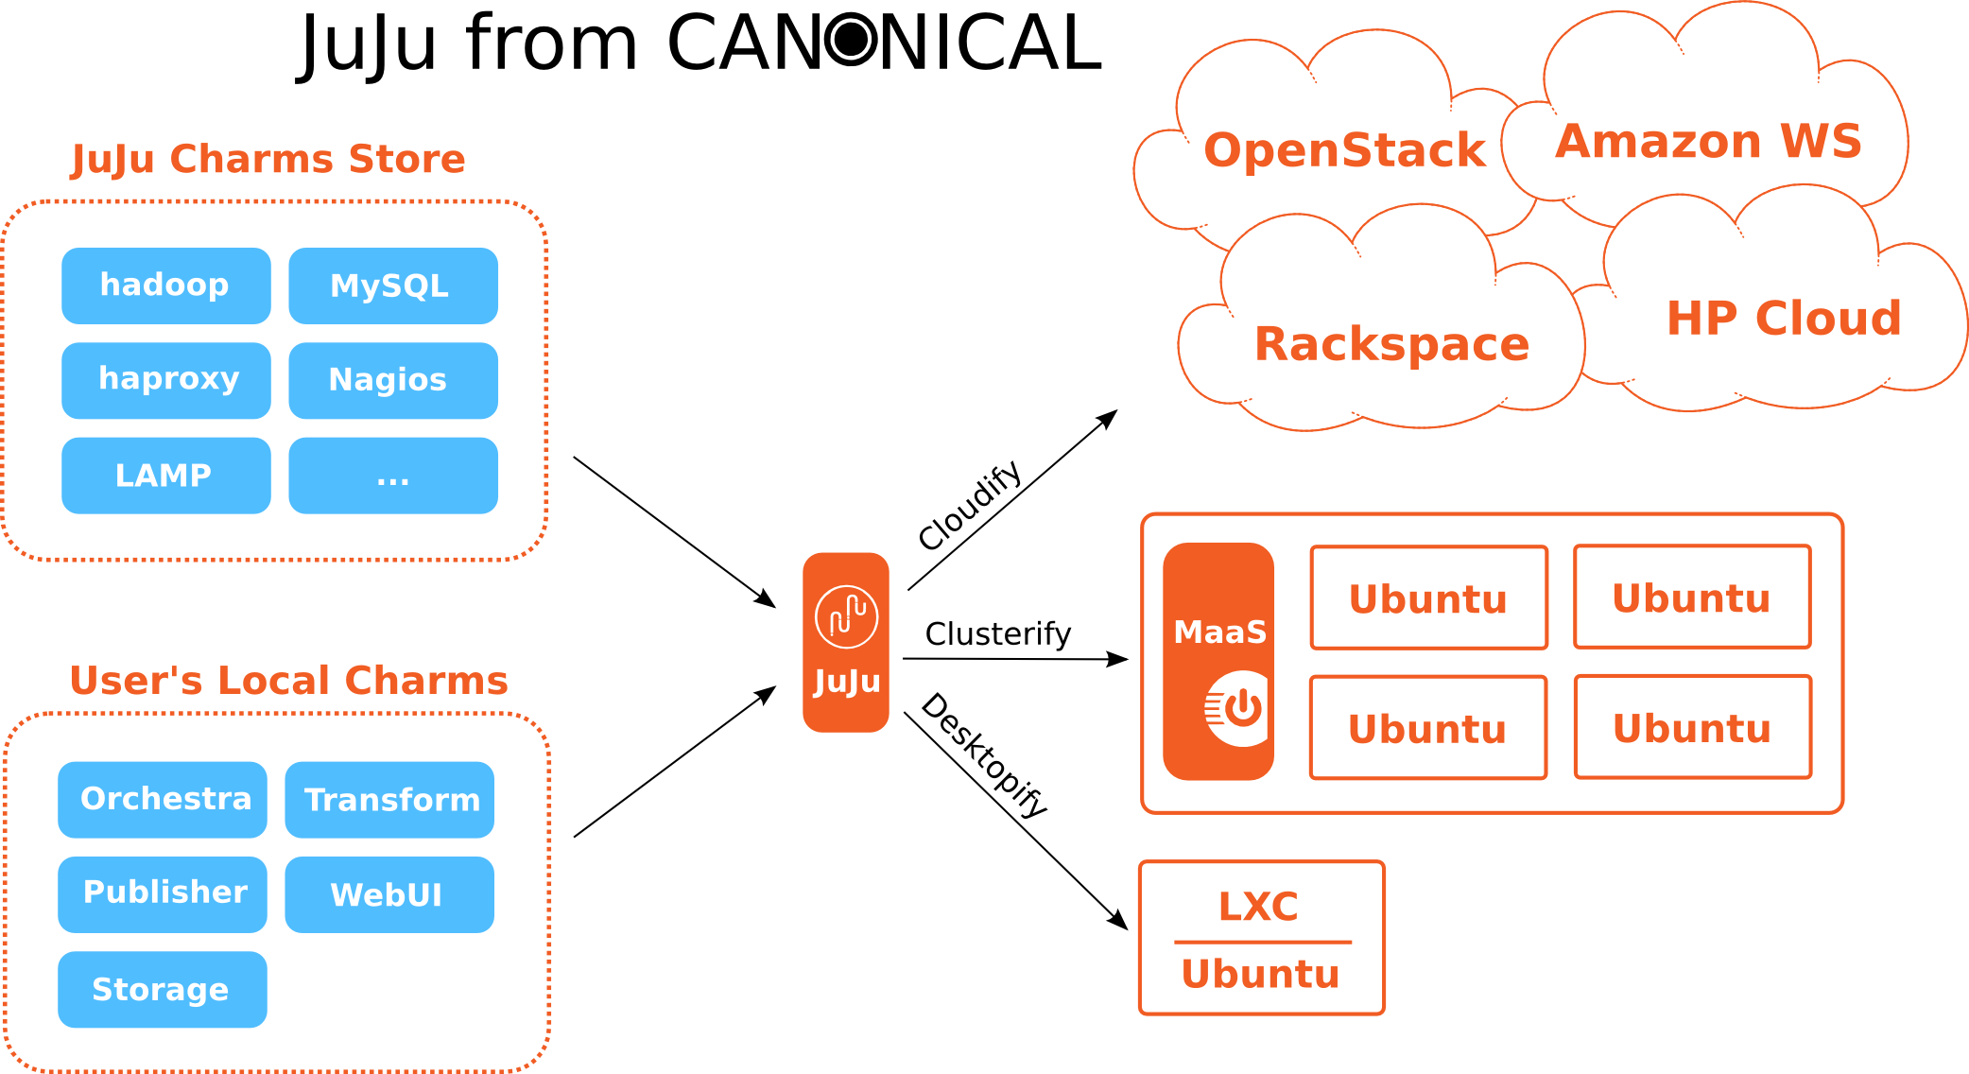
Services Orchestration ...
Services
Hosts

Slide 17
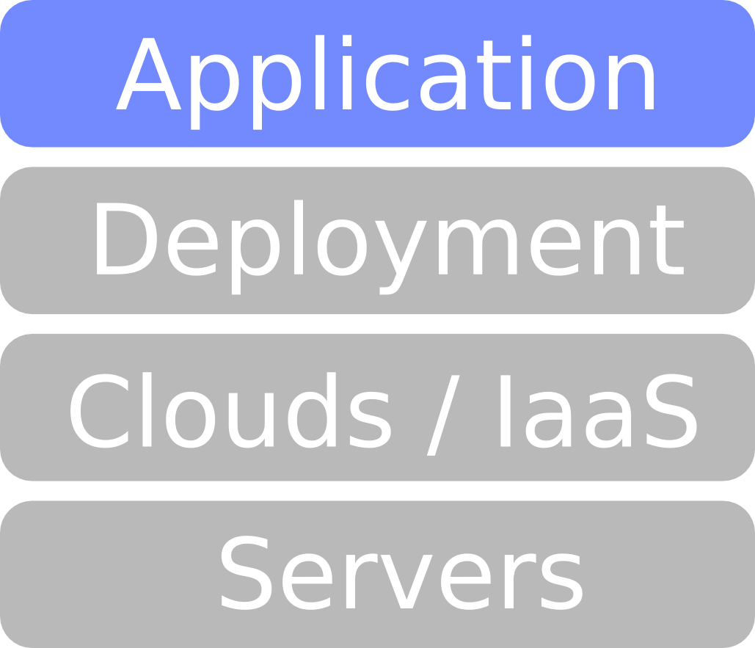
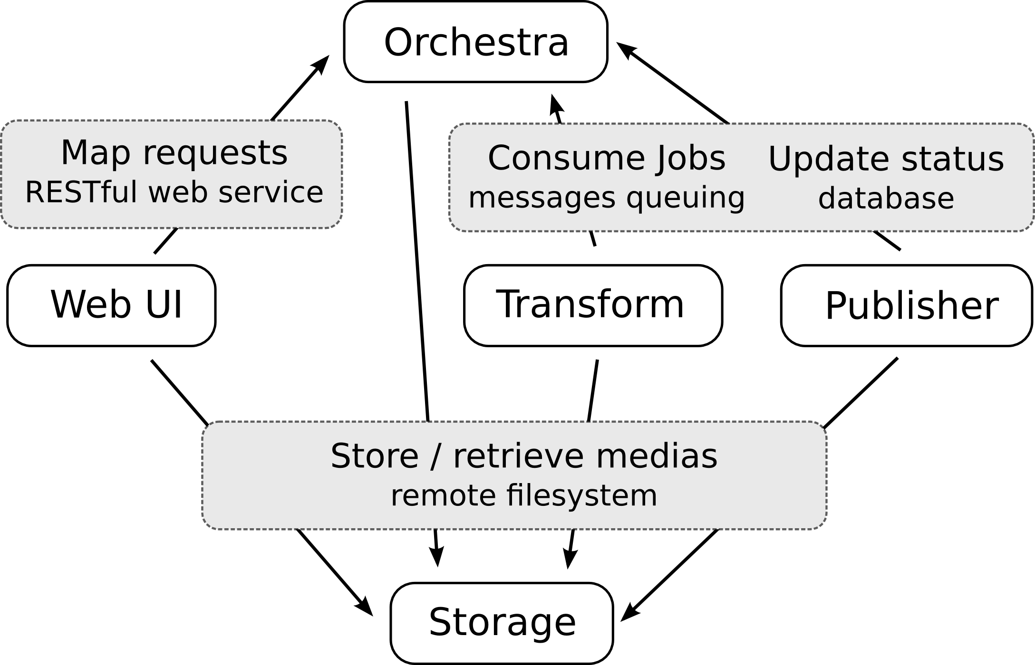
Application Architecture
Relation between components

Slide 18
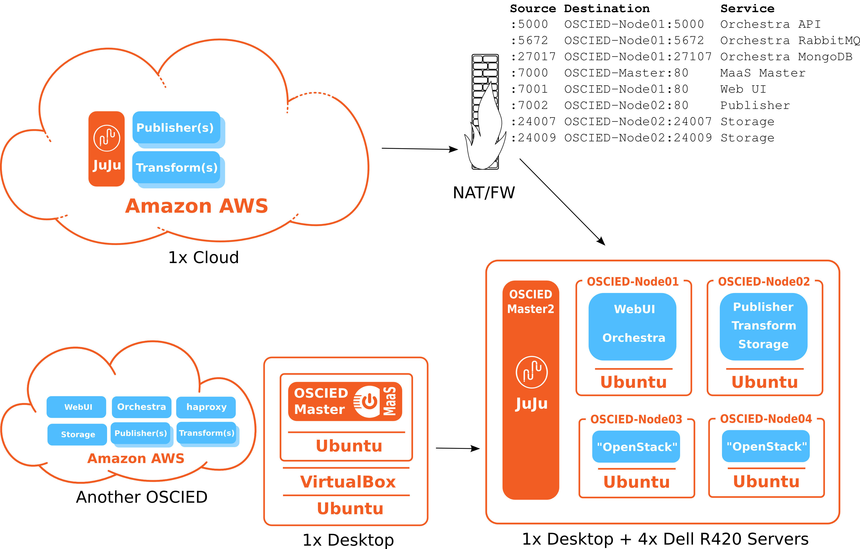
Demonstrator v1.0
March 2013 - Master Thesis
An hybrid setup running in parallel of a 100% public cloud setup.

Slide 19
Demonstrator v2.29.40
September 2013 – IBC 2013 Amsterdam
TODO COMPONENTS

Slide 20
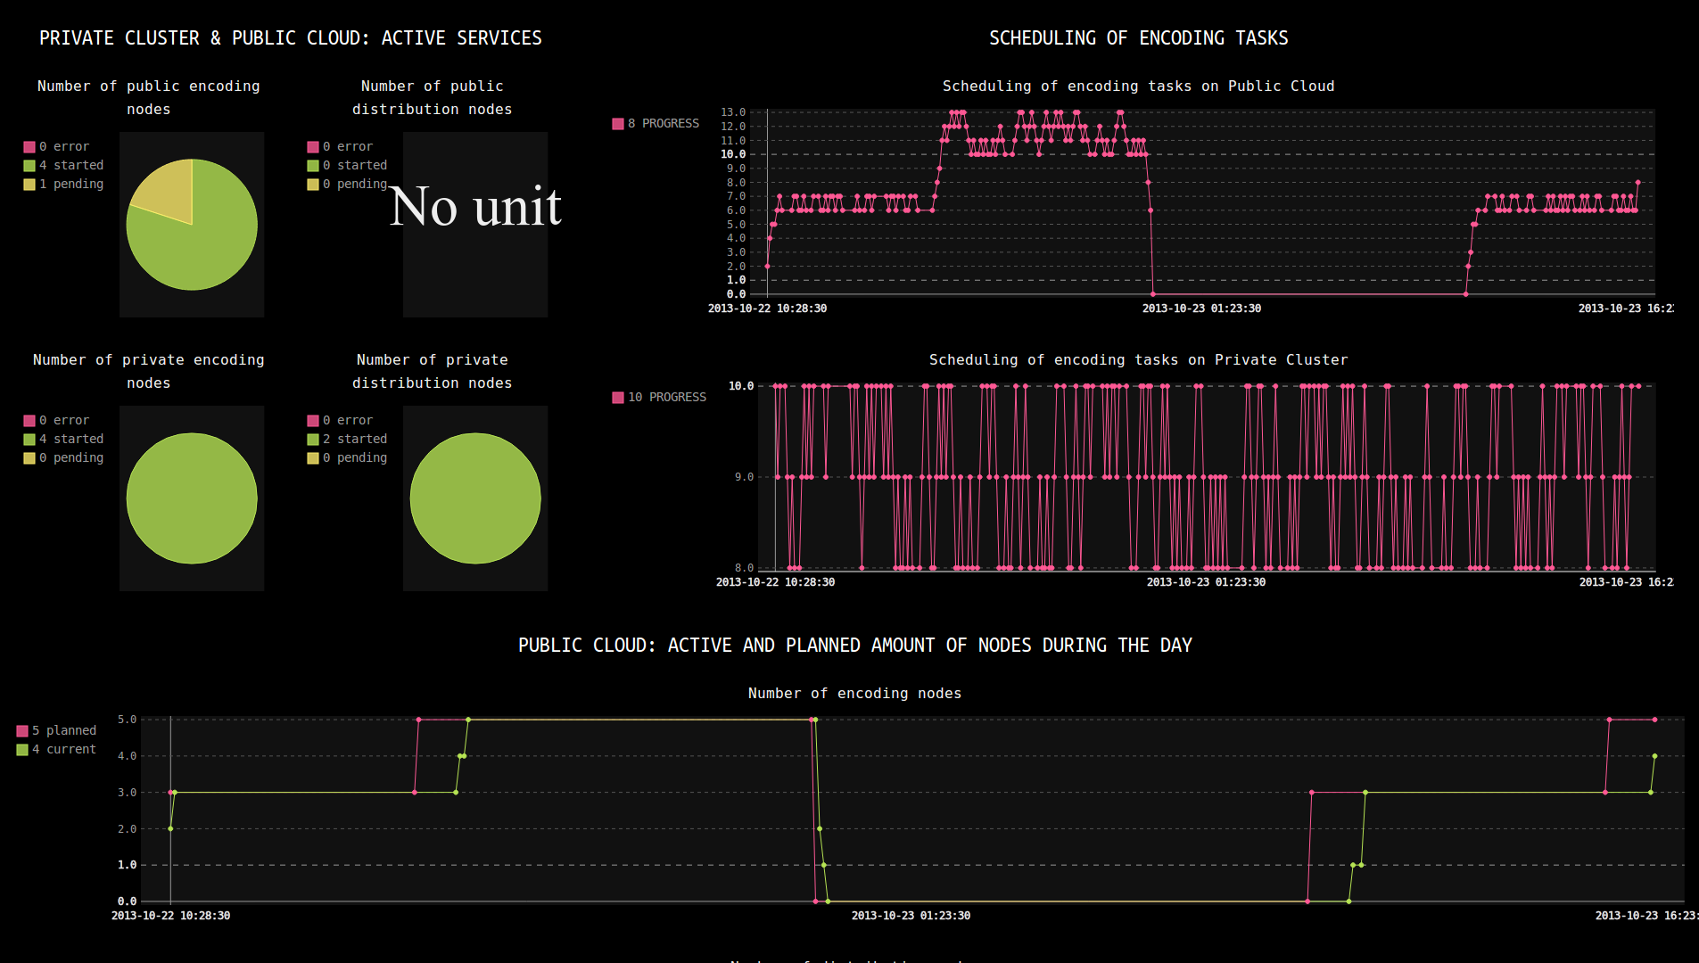
Demonstrator v2.29.40
September 2013 – IBC 2013 Amsterdam
The demo client handling the deployment, scaling and usage of the platform (OSCIED) into the public (Amazon) and private (MAAS) environments.

Slide 21
Demonstrator v2.29.40
September 2013 – IBC 2013 Amsterdam
TODO SCREENSHOT

Slide 22
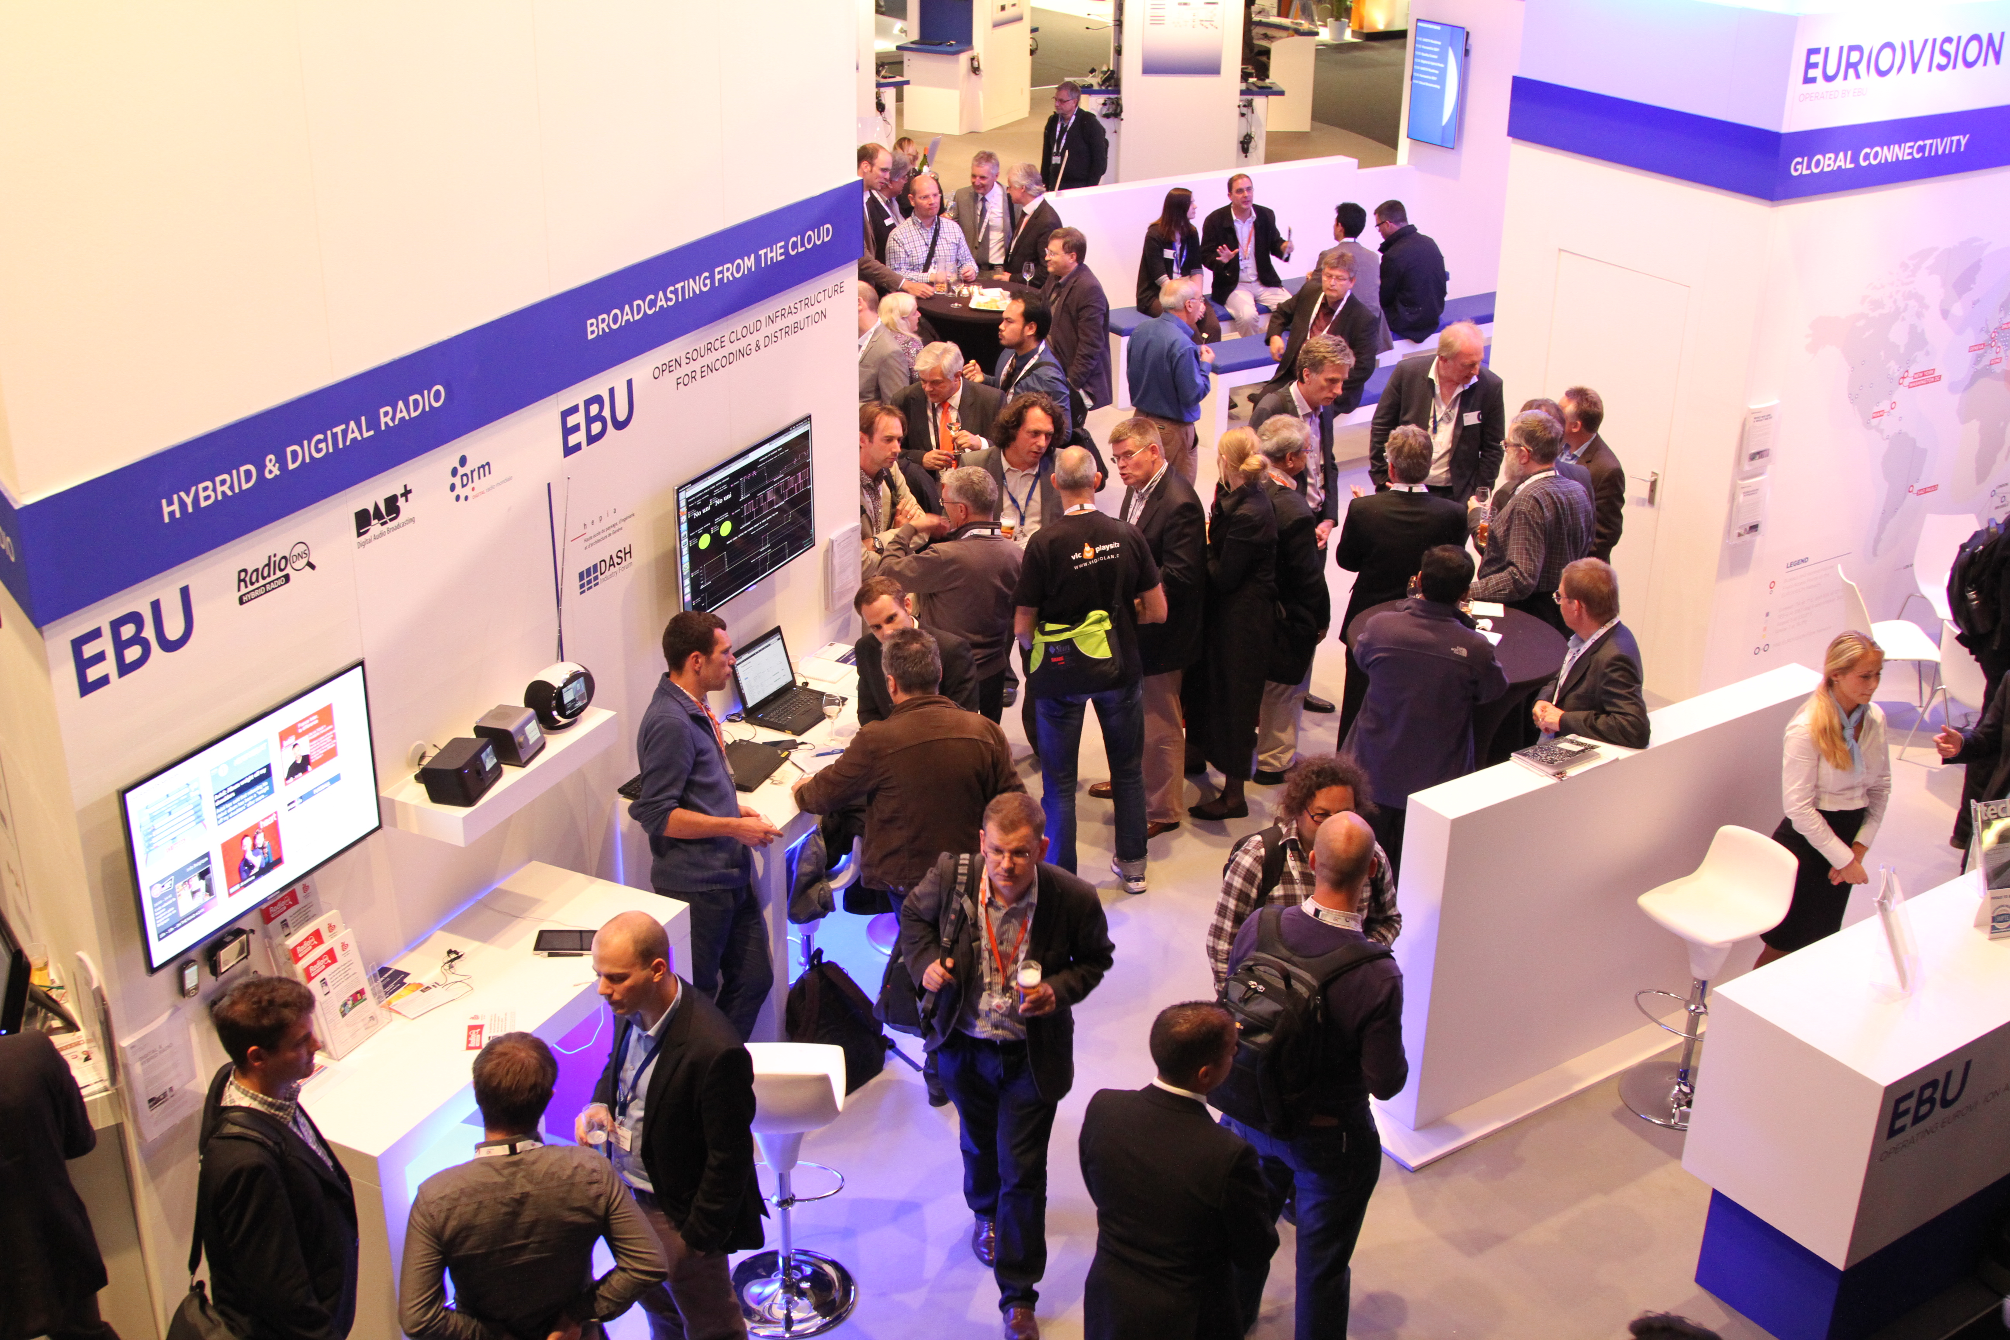
Demonstrator v2.29.40
September 2013 – IBC 2013 Amsterdam

Slide 23
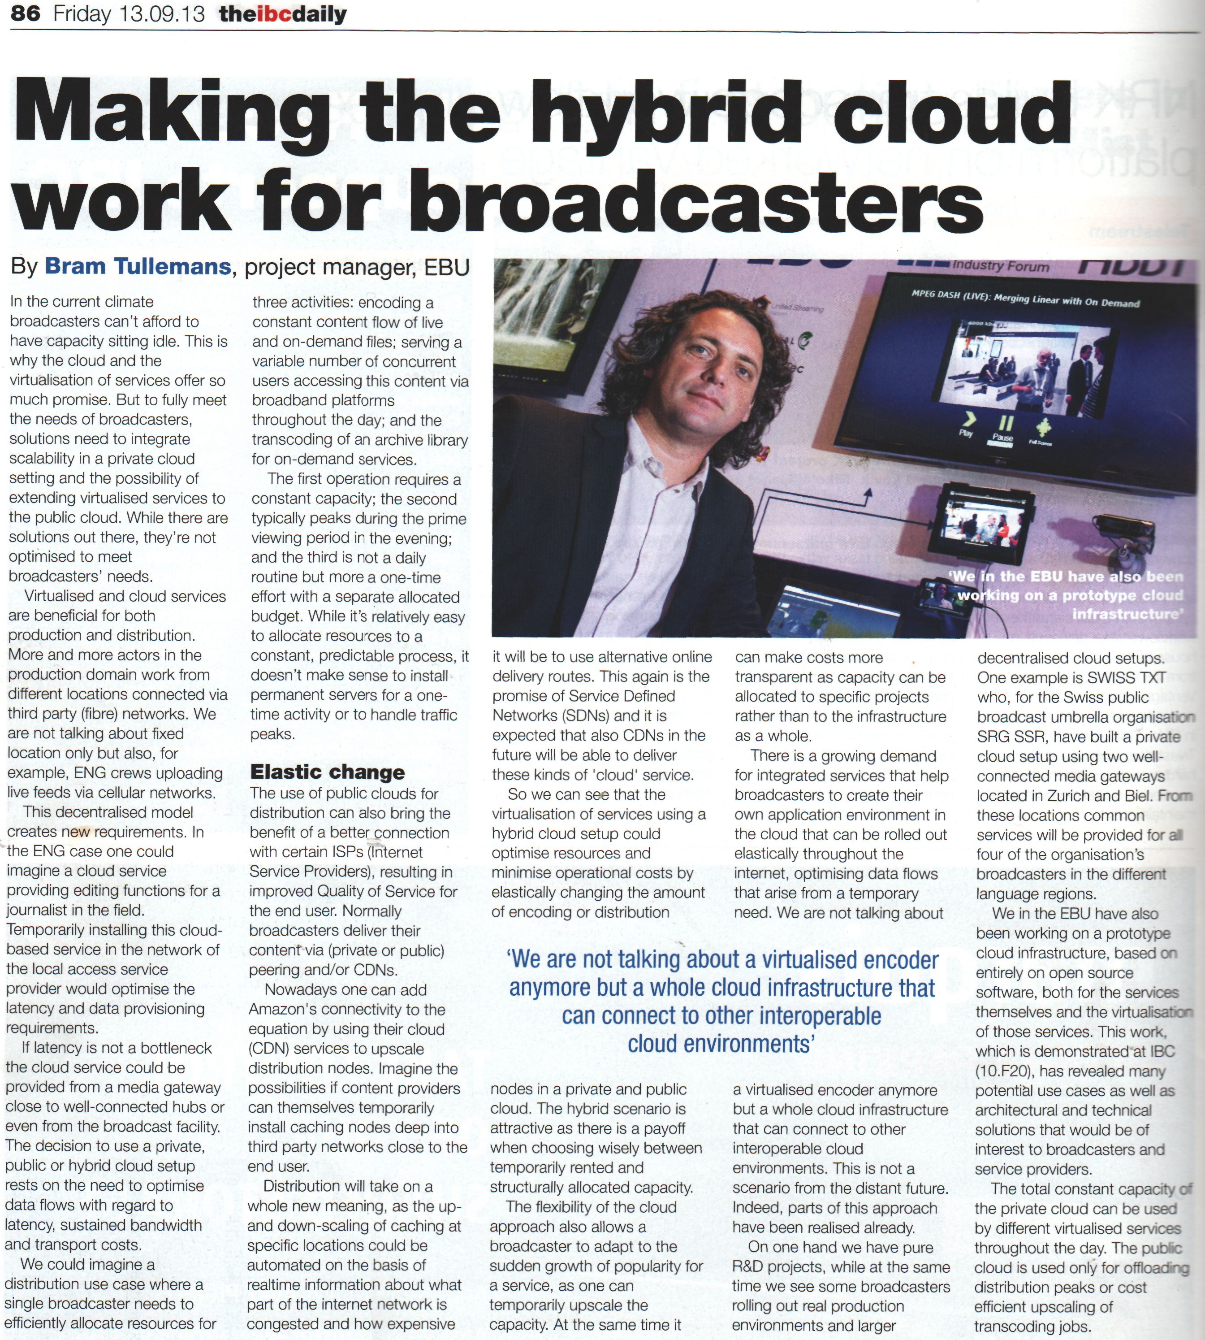
Facts about the demo at IBC 2013
13.09.2013 IBC Daily News
03.2014 FKT Schiele Schoen (DE)
“ FKT (with Radio Technical Notes RTM), the trade magazine for professional television, film and electronic media in Europe. The range of topics publish posts ranging from television and video equipment via the film sound and audio technology to the new media. Practical, timely and competent reporting feature to know this high-profile journal.
FKT readers are decision-makers in the TV, film, audio and video industry. (…) “
http://www.youtube.com/user/FKTonline/about

Slide 24
Conclusion – The Project
Setup OpenStack is a complex, time-taking task. Documentation is not synced with releases, ~breaks compatibility.
Canonical's MaaS & JuJu allow to deploy, connect and manage servers & services in a simple manner !
This demonstrator is an FLOSS media platform allowing EBU's members :
  To use in-house IT resources mixed with necessary amount of public cloud resources
  To easily adapt scale of transcoding and publication services
  To optimize costs of services :
    By adapting CAPEX / OPEX balance based on business needs
    By avoiding « vendor lock-in » to dedicated media services (SaaS) or even Cloud providers (IaaS)
  To test it, use it, even add missing features as it is Free/Libre Open-Source licensed
Developed application is designed to being simple to use but rather powerful :
  Deployment is made easy, thanks to JuJu and developed charm's hooks
  Is elastic, balance of private & public resources is easy and can be automated
  Proof of concept : Open-Source based Encoding and Distribution Platform

Slide 25
Future
OSCIED can grow into a full-fledged media platform with professional management layers :
  Enhancements and future features are already listed on GitHub [1].
  [OK] Add MPEG-DASH encoding capabilities (DashCast/GPAC Team [2])
  [work in progress] Integrate OSCIED to EBU's io platform (common Web UI)
  [scheduled] Accept live MPEG2-TS input feeds / multi-storage architecture / HTTP proxy
  Improve security and avoid single point of failure (SPOF)
  Open Broadcast Encoder for delivering MPEG2-TS feeds (OBE [2])
  Add of automatic scalability functions (e.g. based on business rules)
  Use SaaS services of public Cloud providers (AWS Endcoding [2])
  Distribute with Mist FLOSS Content Delivery Network (DDVTECH [2]) ...
OSCIED was and will be an opportunity for me to work on topics such as FLOSS, cloud, media, automation, cluster storage, API … GitHub, Python, Amsterdam :)
[1] github.com/ebu/OSCIED/issues
[2] Met at IBC 2013

Slide 26
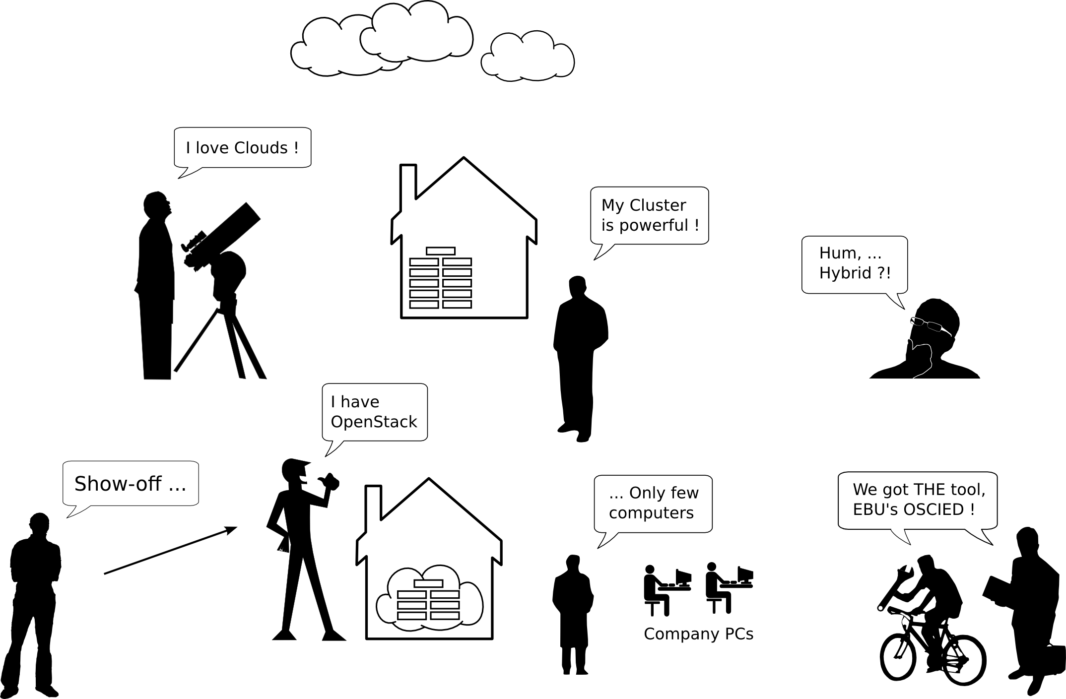
Questions & Answers

